Slide 1
Fast Generation of Result Snippets in Web Search
Turpin, A., Tsegay, Y., Hawking, D. and Williams, H.E.
In Proceedings of the 30th annual international ACM SIGIR conference on Research and development in information retrieval (pp. 127-134). ACM, 2007
Document Compaction for Efficient Query Biased Snippet Generation
Tsegay, Y., Puglisi, S.J., Turpin, A. and Zobel, J.
In European Conference on Information Retrieval (pp. 509-520). 2009
Presented by Erika Siregar
CS 834 - Introduction to Information Retrieval
Fall 2016
Old Dominion University
November 3, 2016
Notes:
Turpin, A., Tsegay, Y., Hawking, D. and Williams, H.E.

Slide 2
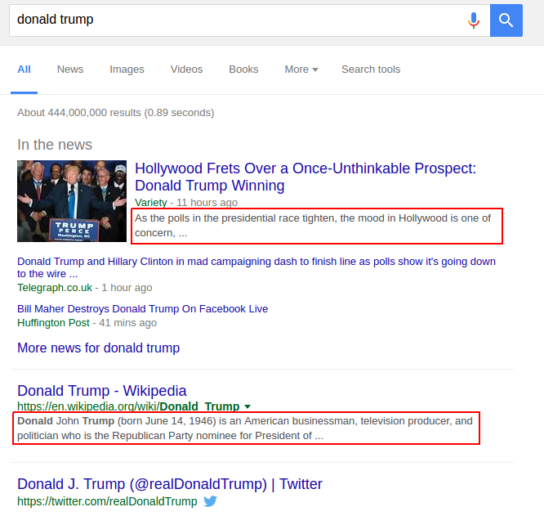
What is Snippet?
Short fragment extracted from document
A sneak preview of the document contents.
Two types of Snippet:
Static
Query-biased
Title
URL
Snippet
Notes:
Short fragments of text extracted from the document content (or its metadata).
Static → Show the first n words of the document
Query Biased → Selectively extracted on the basis of its relation to the searcher’s query

Slide 3
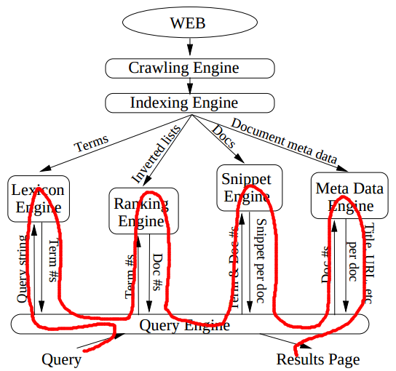
How snippet is generated?
Lexicon engine → maps query terms to integers
Ranking engine → retrieves inverted lists for each term and use them to get a ranked list of documents
Snippet engine → use document numbers & query term numbers to generate snippets.
Metadata engine → fetches information (title, URL, etc)
Fig. 1 Abstraction of some subsystems in search engine
Notes:
Each subsystem has its own:
Data
Process
Memory management scheme
Query engine has query cache that stores precomputed result pages for very popular queries

Slide 4



So, What is The Problem?
Query-biased Snippet is dynamic.
Storage → Order of ten billion web pages
Load → Hundreds of millions of search queries per day
Response → File accessing is a major bottleneck
Deal with these ...
we don’t want to waste our time waiting for the snippet
users
Search engine

Slide 5
Identify the running time ...
Majority of time spent generating a snippet is in locating the document on disk (seek): 64% for whole documents.
With 1% of documents cached → around 80% of disk seeks are avoided

Slide 6
How to speed up?
Utilize the in-memory Cache
Reducing Disk Access
Document Compression
The smaller document size, the more documents can be cached
Document Compaction
Consider only the important part

Slide 7
Caching
What should be cached?
Document cached → Frequently accessed documents
Query cached → Precomputed result pages for popular queries

Slide 8
Document Compression
Compression is processed by Snippet Engine
Proposed Compressor → Compressed Token System (CTS)
Well-known Compressor (baseline) → Zlib Compressor Library

Slide 9
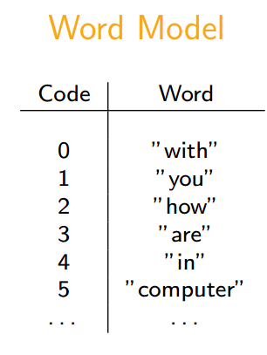
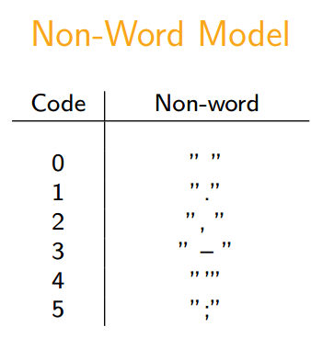
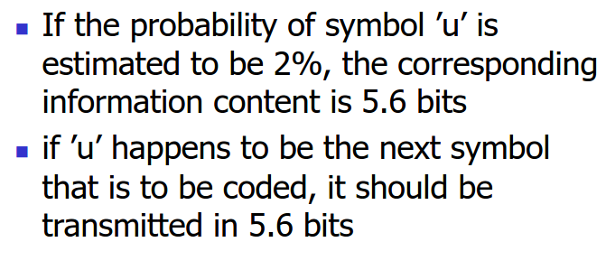
How CTS Works?
Parsing the document
Remove tags
Determine the beginning and ending of a sentence
Restrictions: 5 <= sentence words <= 20
Output: word tokens & non-word tokens (punctuations)
Pruning algorithm
Collect the words and non-words tokens
Construct model → estimate distribution of the term frequencies
Discard rare tokens (low frequency) → save storage
Encode using vbyte scheme → higher frequency = smaller bits
Replace the tokens with their vbyte codes
Discarded tokens are replaced with ESCAPE symbol.

Slide 10
Experiment
Data: WT100G, WT10G, WT50G
Queries from Excite logs (http://msxml.excite.com/) in 1997
All queries are stemmed, stopped, and sorted alphabetically.
Use Zettair search engine → get the list of documents for each query.
Okapi BM25 → document rank
Score for each document is independent of any query.
Notes:
Use data from TREC collections:

Slide 11
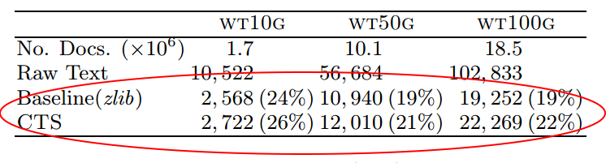
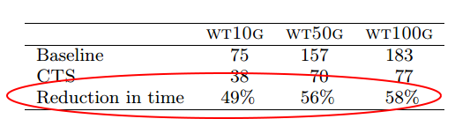
Is CTS Better Than Zlib?
In compression, CTS loss over zlib, both reduce about 20% of the original size
But, in snippet generation time, CTS performs about 50% better than Zlib
Table 1: Total storage space (Mb) for documents for the three test collections both compressed, and uncompressed.
Table 2: Average time (msec) for the final 7000 queries in the Excite logs using the baseline and CTS
systems on the 3 test collections

Slide 12

Compaction
Reorder sentences by significance → Consider Only The Important Part
The techniques:
Natural order → First sentence should introduce paragraph. Happened in Well Authored Document.
Significant terms (ST) → Score based on term frequency
Query log based (QLt) → Score based on past query terms. Move sentence with many past query term to front.
Query log based (QLu) → Same as QLt, but considers only unique terms

Slide 13
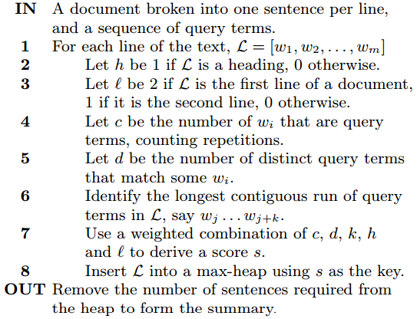
Sentence Ranking
Document is broken into sentences S where S = [w1, w2, ...,wm].
Query Q where Q = {q1, q2, ..., qn}
Notes: h → sentence is a heading l → sentence is first or second line of document k → length of longest contiguous run of qi in S c → count of wj ∈ Q d → c minus repititions
Figure 2: Simple sentence ranker that operates on raw text with one sentence per line

Slide 14
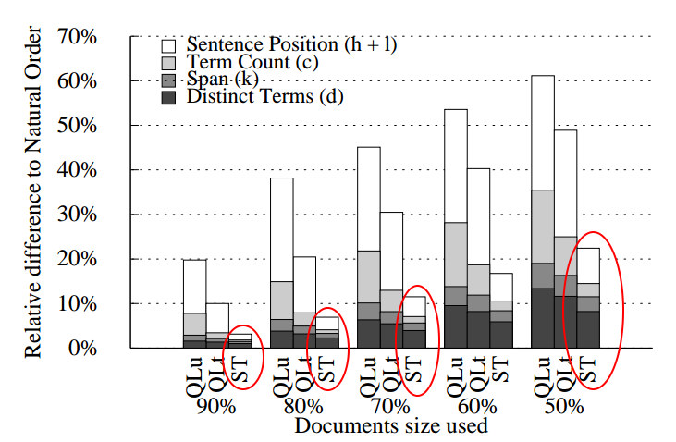
Which Technique is Better?
Significant Terms (ST) wins.
The greatest change over all methods is in the sentence position (h + l) component of the score
Figure 6: Relative difference in the snippet score components compared to Natural Ordered documents when the amount of documents processed is reduced, and the sentences in the document are reordered using Query Logs (QLt, QLu) or Significant
Terms (ST).

Slide 15
Could we have a better document compaction method?
Let’s go to the paper 2 …

Slide 16
Why focus on document compaction?
Reduce disk seeks and reads.
smaller size → more documents in the cache
Fewer sentence to evaluate during scoring phase.
Problem with the previous (CTS):
CTS relies on query logs, which has 2 shortcomings:
The drift of the query natures must be followed by the change of the document representation → computational overhead
The presence of a suitable query log is assumed.

Slide 17
New idea...
New compaction approach
Reordering the sentences based on their scores
Pruned the documents to the desired length
Use this pruned version as the surrogates of the full document.

Slide 18

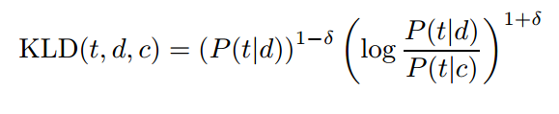
How to reorder?
Investigating 2 methods:
TF.IDF weighting
Kullback-Leibler Divergence

Slide 19
How to prune?
Considering 3 methods:
Fixed percentage of sentences → used
Fixed number of sentences
Threshold T

Slide 20
Experiment
Data from TREC Corpus → WT10G, WT100G
Excite query logs

Slide 21
Generating the snippets
Parsing
Tokenizing → words and non-words
Identifying sentences
End sentence marker → . ? !
HTML tags → <h1>, </h1>, <p>, </p>, and <br/>
Length threshold → max. 30 words
Scoring the sentences
Simplify Turpin’s method
Sort sentence by:
Primary key → count of unique query terms in the sentence
Secondary key → longest span of query terms in the sentence
Replace Turpin’s tertiary key (total count of query terms in a sentence) with TFIDF
Remove duplicate sentences
Duplicate = 80% of same contents with n-gram 5
Notes:
favor sentences that contain query terms repeated many times, a large portion of which are spam sentences, and not useful for the purpose of summary generation.

Slide 22
Evaluation
Snippet generated from pruned document
Vs
Snippet generated from full document.

Slide 23
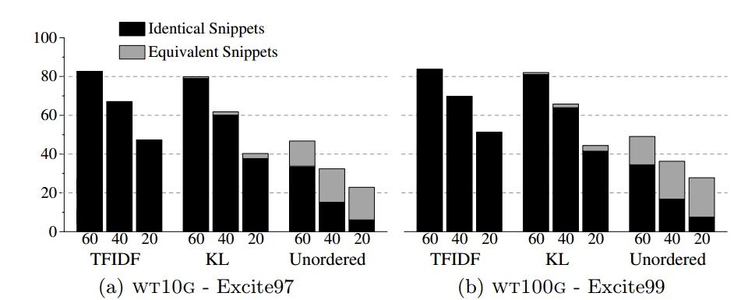
Results
Fig. 1. Quality of snippets generated from wt10g for Topics 451-550. Documents were reordered using the various reordering schemes and then pruned. The dark bars indicate the percentage of pruned documents with identical snippets to the full documents while the light colored bar indicates those that generated snippets with the same QBS score.

Slide 24
How to ensure that this is a good snippet?
What if there is any degradation?
Simple-go-back (SGB) approach:
Check if the snippet contains sentences with no query term.
Check if the number of query terms in snippet < number of query terms in the index.
If TRUE → sentences contain query terms were removed.
Generate snippet from the full document.
Notes:
if a snippet contains a sentence with no query term and the
total number of the query terms in the snippet is less than the total number of
query terms in the index, then we can determine whether sentences containing
query terms were removed from the pruned document.

Slide 25
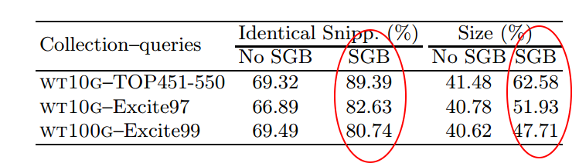
SGB vs No SGB results
Table 2. Percentage of snippets produced that are identical to those produced with whole documents, and the amount of data (percentage of whole documents) processed per snippet, with and without SGB

Slide 26
Conclusion
Paper 1:
Devise new approach for faster snippet generation:
Cache
Compression → Compressed Token System (CTS)
Compaction
Paper 2:
Improve the compaction method used by CTS
Generating snippet from pruned document.
Over 80% identical snippets.

